Slide 1
Playing fiasco
Download Fiascomatic from the Fiascomatic page on Canvas
Or you can download it directly from github: https://github.com/ianhorswill/Fiascomatic/releases

Slide 2
Break into groups
3-5 players
Larger is more fun
Smaller let people be more active
Sit in a group
Pick two colors of chips
One to mean “good ending”
One to mean “bad ending”
Get one chip of each color for each player
Put the chips in a pile in between the players

Slide 3
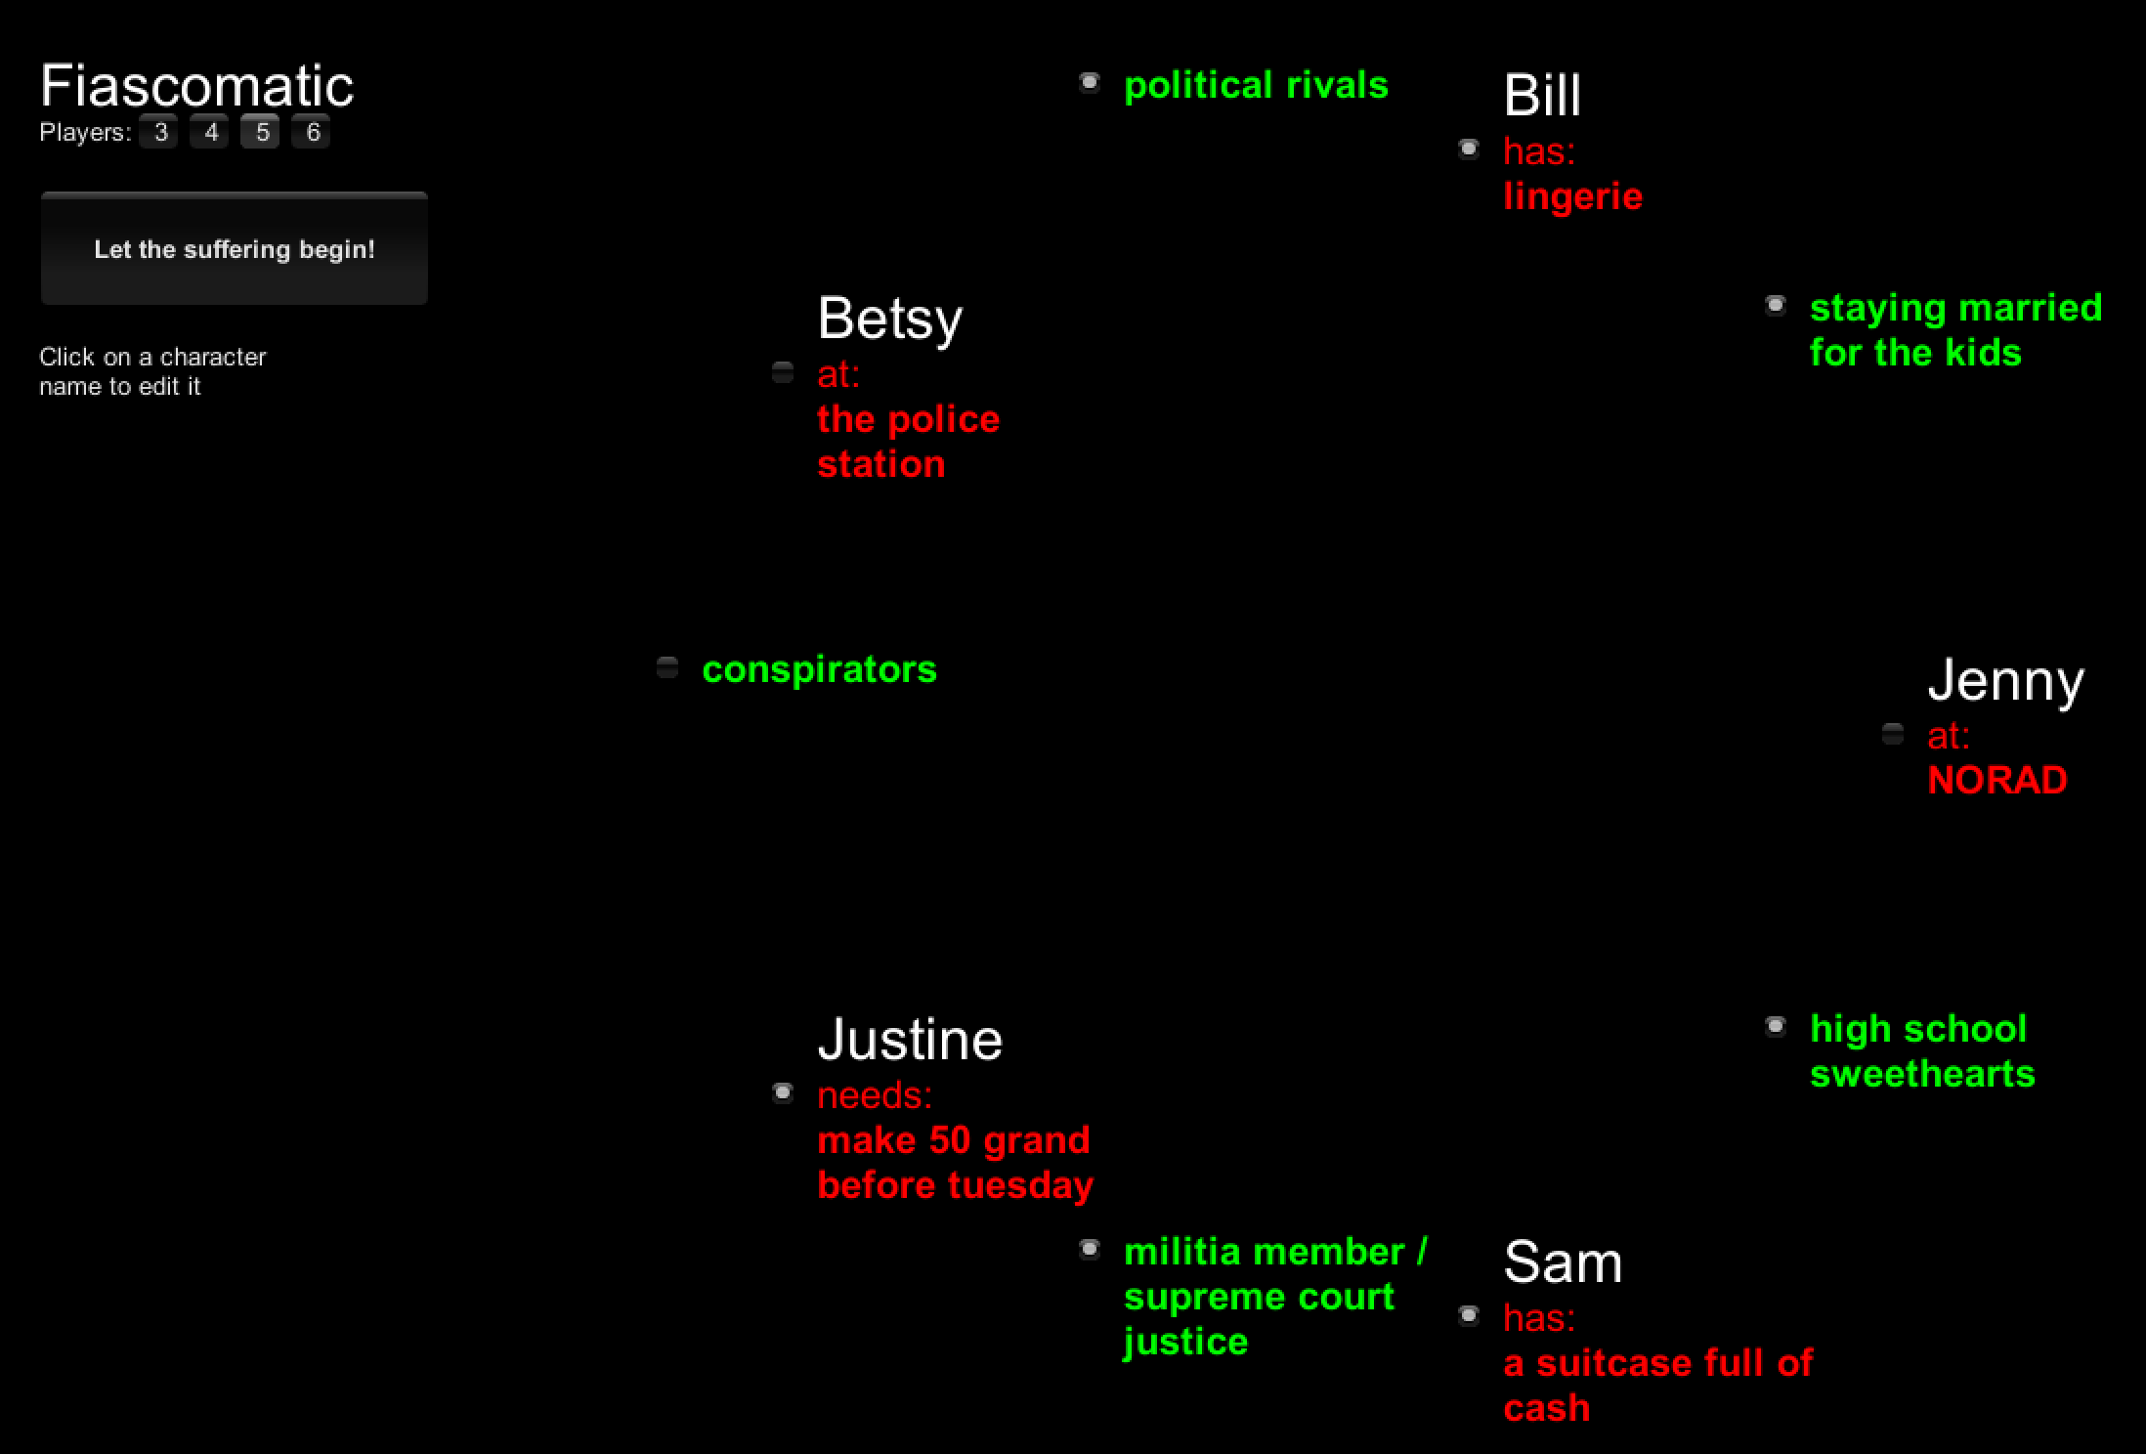

Slide 4
Rules for Fast Fiasco
Use Fiascomatic to generate a setup
A relationship between each pair of players
A detail (object, need, or location) for each player
Feel free to generate a few and choose the one you like
Go around the group
Do a scene centered on each player’s character
The player chooses whether they will establish or resolve the scene
If you have time, do another round

Slide 5
Establishing a scene
Describe who is in the scene
Player characters
Non-player characters
If there are NPCs, someone has to be available to play them
Where it takes place
(Briefly) the situation
Manny is trying to convince Sally to kill Bruce
Jennie is trying to buy some drugs
George is trying to convince Joe not to leave him

Slide 6
Playing a scene
Stay in character
Improvise the scene
Let it go wherever it’s going
Just try to make a good story
Continue until the scene reaches a natural stopping point
Don’t
Try to impose your will in the scene
Try to inject new facts into the story
Especially about other characters
“Bill is actually a spy!”
Play CalvinBall
“Oh yea? Well, my character has X-ray vision!”

Slide 7
Optional: Stage, camera, editing directions
You’re pretending to make a film
So you can break character to describe things like
How the camera moves
“Close up on an eye; the camera pulls back to show a dead body”
Shifts in time and editing
“Flashback to Bill and Jenny meeting for the first time at an anime convention”
“Smash cut to Sally watching the timer ticking away on the bomb. It says 0:05. Sally says, ‘well, fuck!’. ”

Slide 8
Resolving a scene
When you think you see how the scene is going
Don’t break character
Pick up a chip from the table
Color indicating whether it’s a good or bad ending
Show it to the group
If the group is resolving
They have to nod in agreement
Continue improvising in character to enact the chosen outcome
Note
The fixed collection of chips forces an equal number of good and bad endings
If you run out of one, then all the remaining scenes will have to go the other way

Slide 9
Collaborative play
Build on others ideas
Not blocking
“Yes, and”
Playing for others
What does the other player think is going on?
What does the other player want?
How do I give it to them?
Lose gracefully

